Slide 1


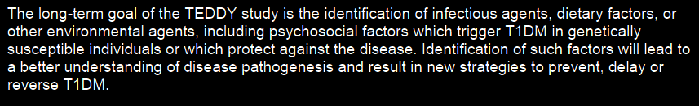
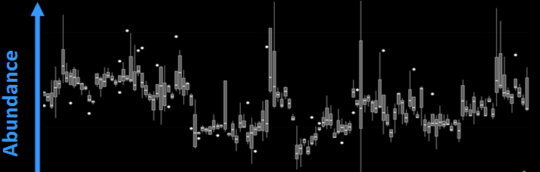
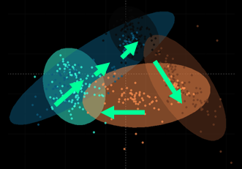
Large longitudinal studies may be required to identify small phenotypic and environmental effects
TEDDY: The Environmental Determinants of Type 1 Diabetes in the Young
multi-Omic longitudinal study involving > 15,000 samples acquired over 3 yrs
Analytical batch effects can hide smaller biological effects
Time
Time
http://teddy.epi.usf.edu/TEDDY/

Slide 2
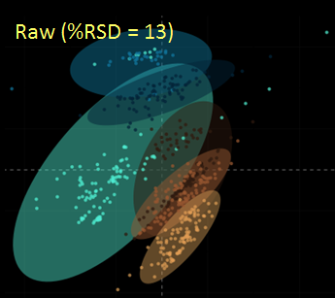
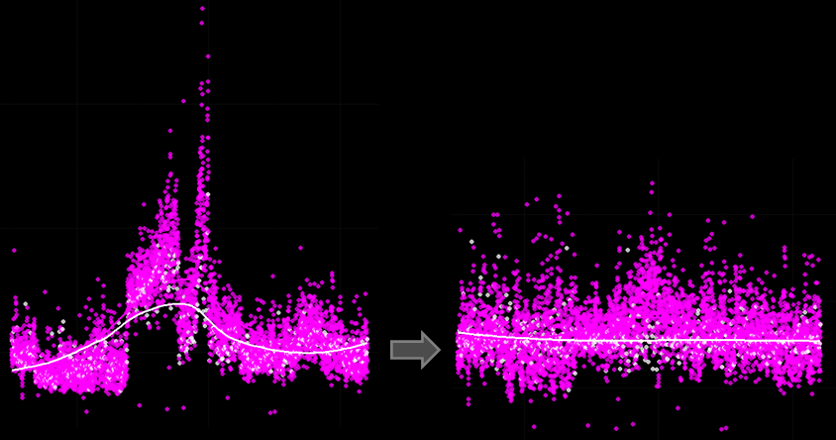
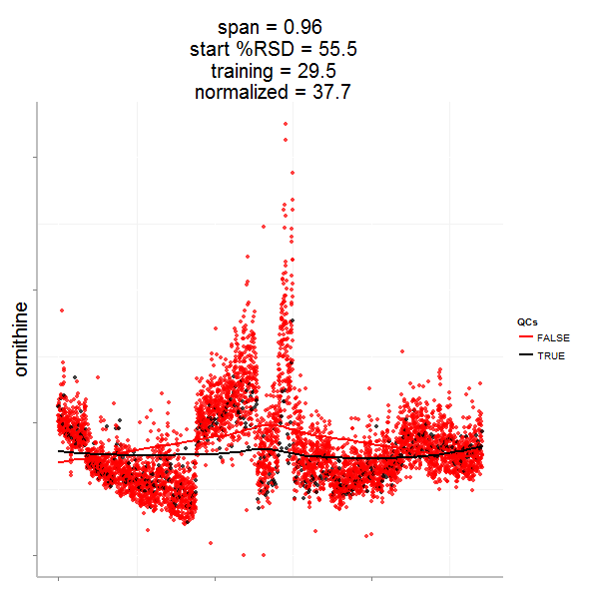
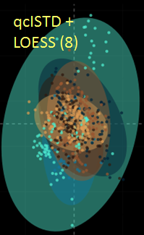
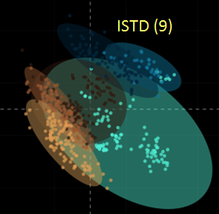
Data normalization may require a combination of approaches
Internal standard (ISTD) based normalization may not fully remove analytical batch effects
Analytical replicate-based normalizations can be used to estimate and remove analytical variance
Raw Data
Normalized Data
Samples
QCs
LOESS

Slide 3

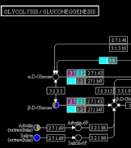
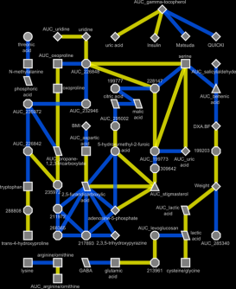
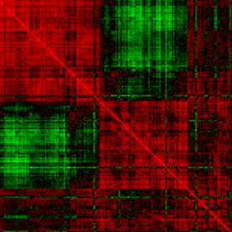
Omic’ data integration strategies
Biochemical pathway
Network based
Empirical correlation
Biomarker Insights 2015:Suppl. 4 1-6 DOI: 10.4137/BMI.S29511

Slide 4
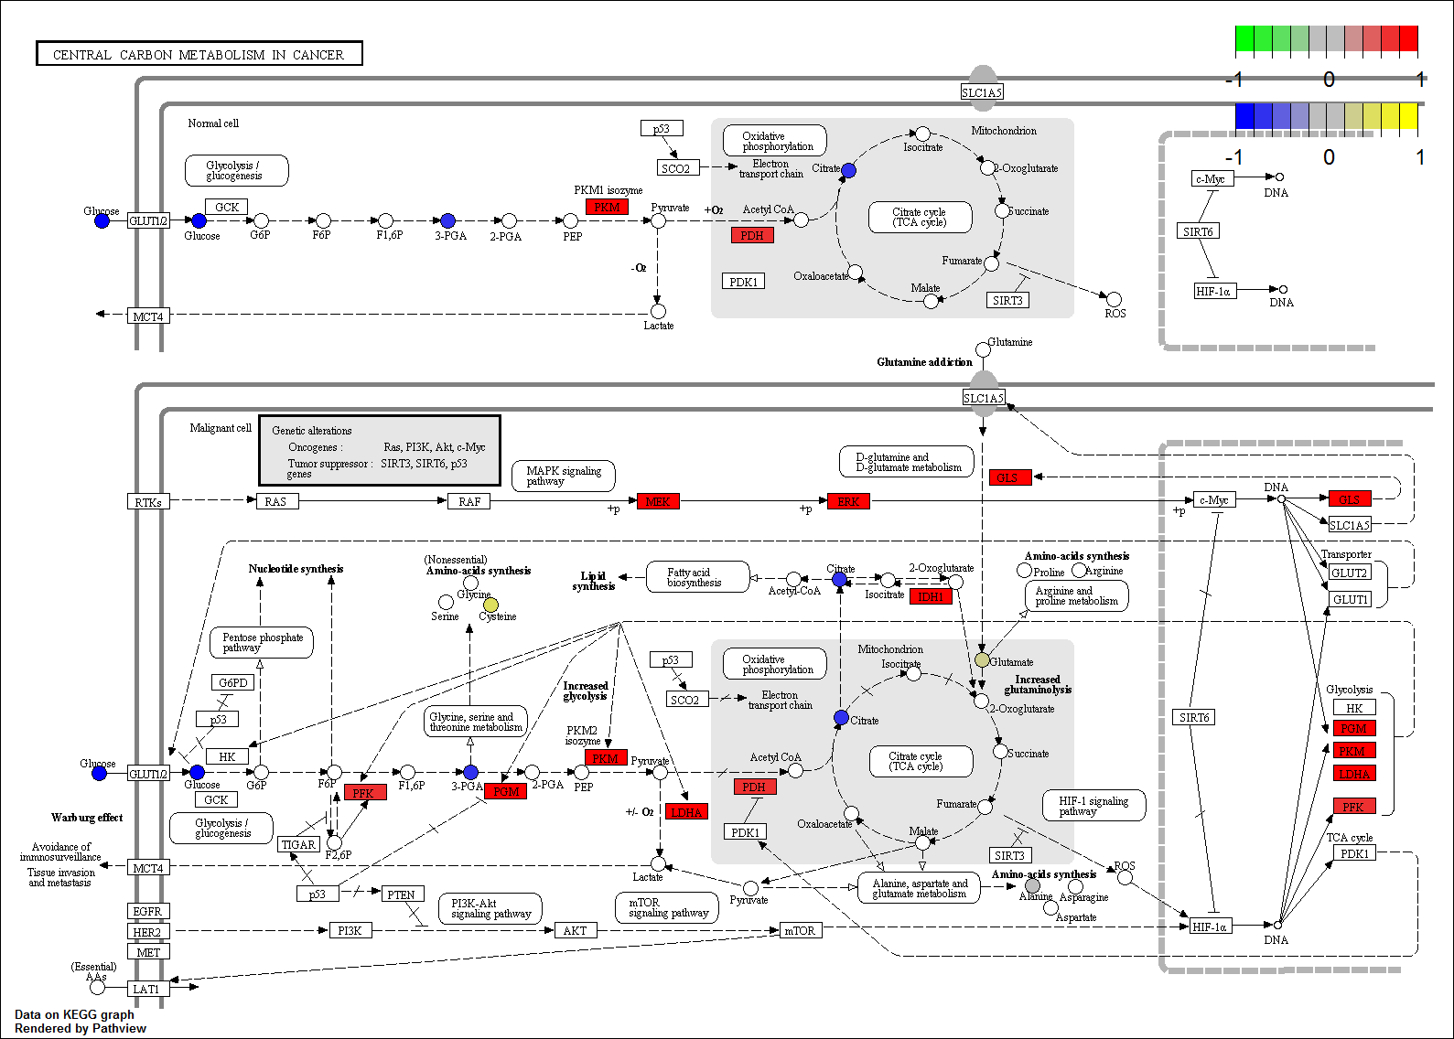
Pathway analysis

Slide 5


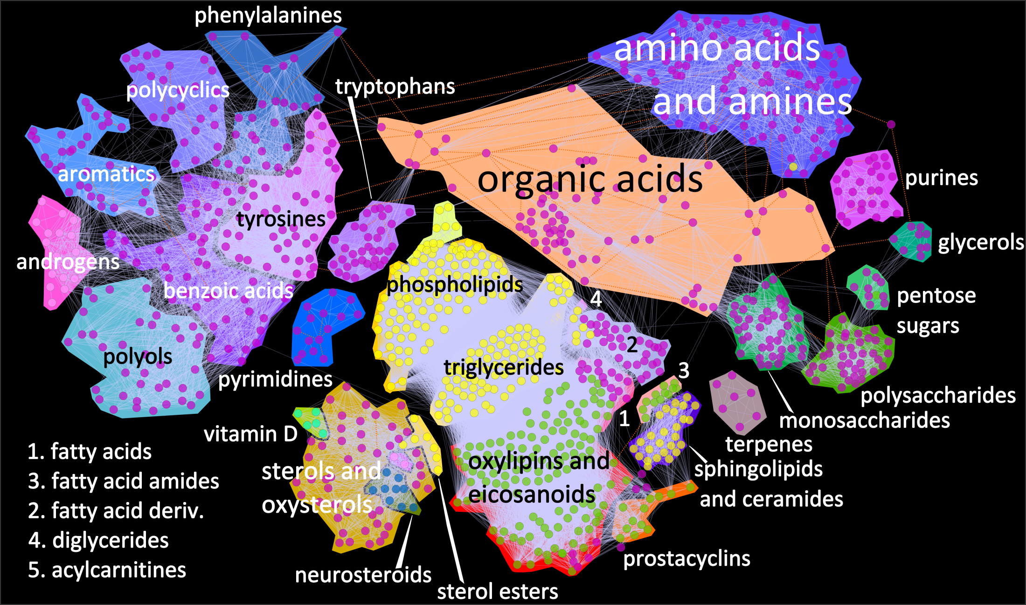
Metabolomic network analysis

Slide 6
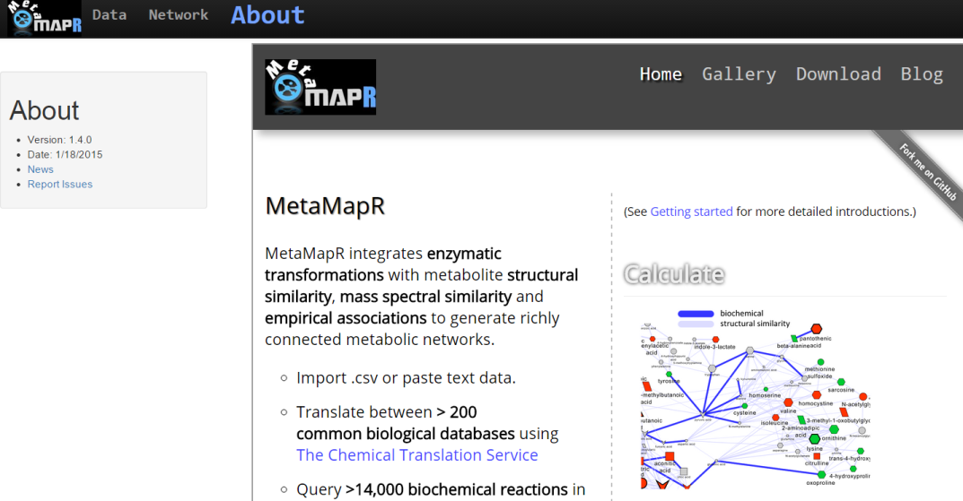



MetaMapR: Metabolomic network calculation
http://dgrapov.github.io/MetaMapR/

Slide 7
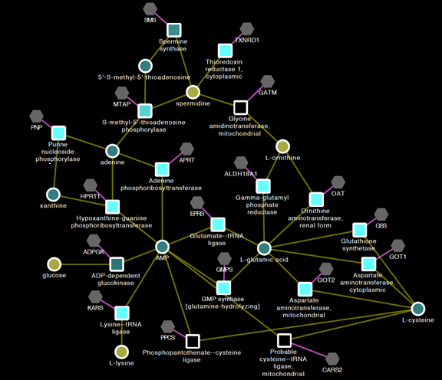
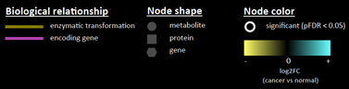

Omic’ network analysis
http://kwanjeeraw.github.io/grinn/

Slide 8
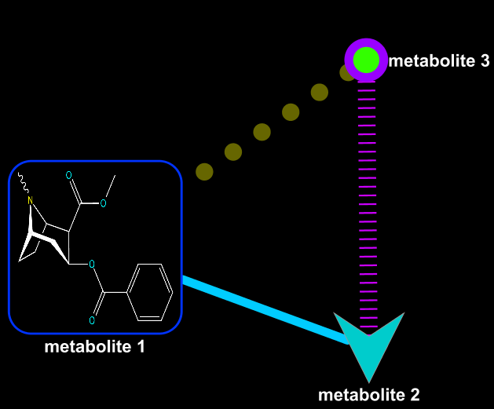
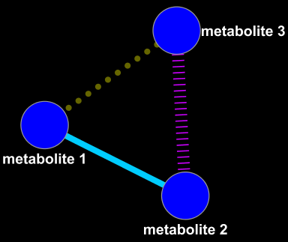
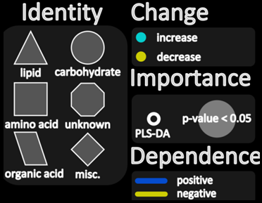



Network Mapping
+
=
Network
Mappings
Mapped Network
Grapov D.,American Society of Mass Spectrometry Conference (2013, 2014)

Slide 9
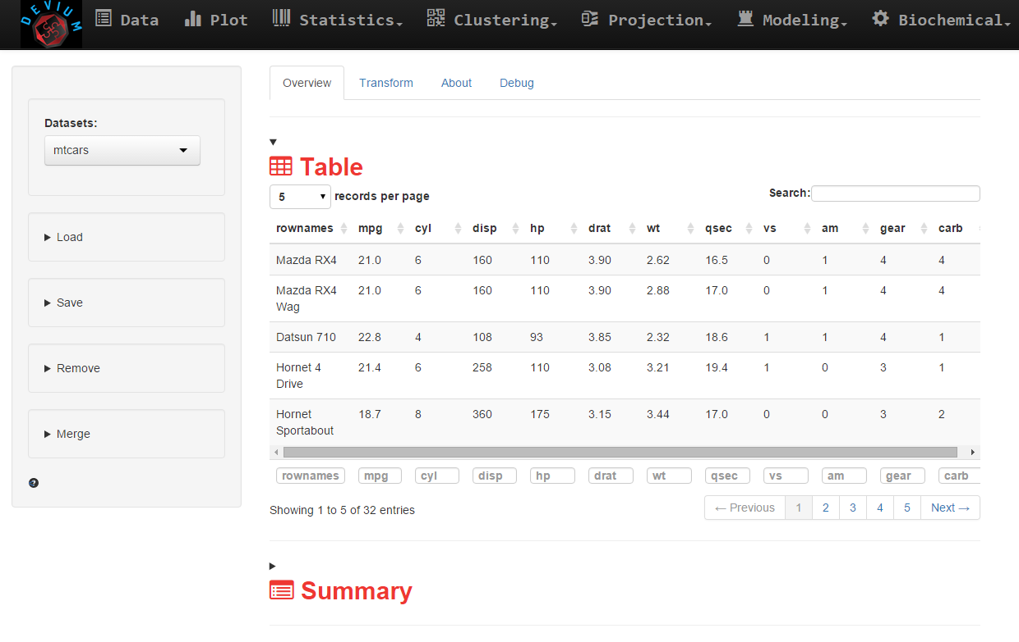
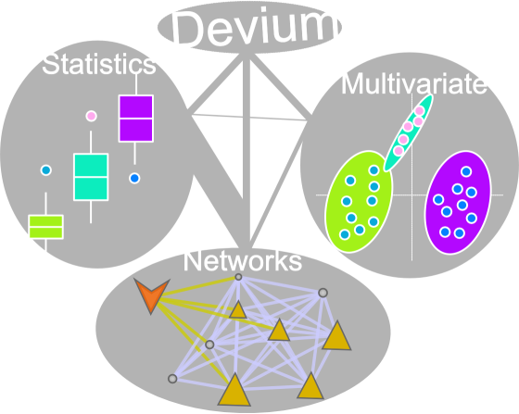
DeviumWeb: Data analysis and visualization
https://github.com/dgrapov/DeviumWeb

Slide 10

Questions?
dgrapov@gmail.com
More information:
https://imdevsoftware.wordpress.com/
Software:
https://github.com/dgrapov
Hire me:
createdatasol@gmail.com

